Slide 1
Group 6 Final Project
Alex Cassells, Ben Ives, Matt Oliver, Matt Read, Brad Williams

Slide 2
Background
Goal: Create Python library that integrates with Bloomberg API for certain bond calculations
Go beyond the scope of what Bloomberg does
Add additional calculations
Coupon Payment
Days to Maturity/Days to Next Coupon
Coupon Frequency (number of days)
Number of Coupons
Duration
Notes:
Matt O

Slide 3
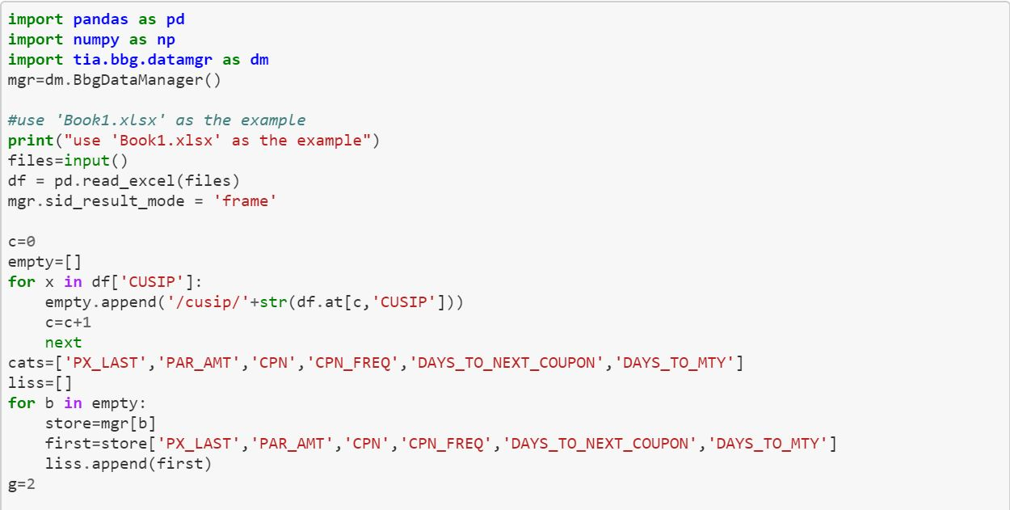
Code
Import required libraries
Tia is a 3rd party Github library
Create the API connection
Ask what excel file you are using
Read that as a dataframe
Format each CUSIP in a way that the API can read
Have the API pull certain data

Slide 4
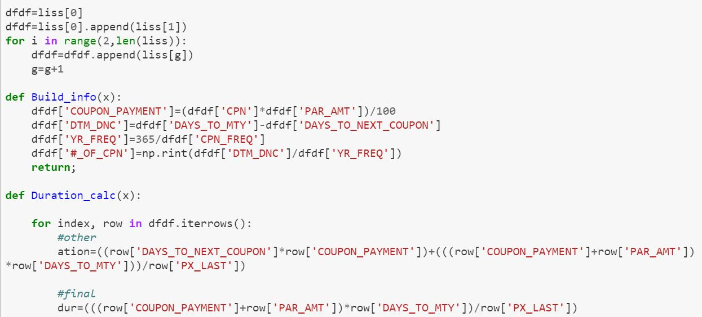
Code (continued)
Format the list of data as a dataframe
Build_info
Calculates bond data that Bloomberg does not
Duration_calc
Calculates duration of the bond

Slide 5
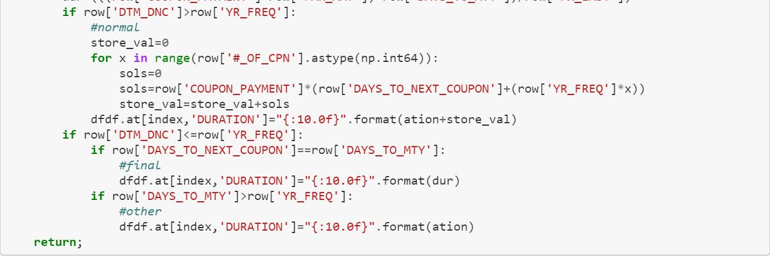
Code (continued)
Further calculation of duration from previous slide

Slide 6
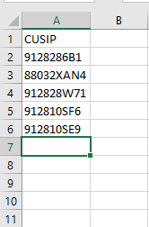
Demo
Source data
We used five CUSIP’s but there is no limit

Slide 7
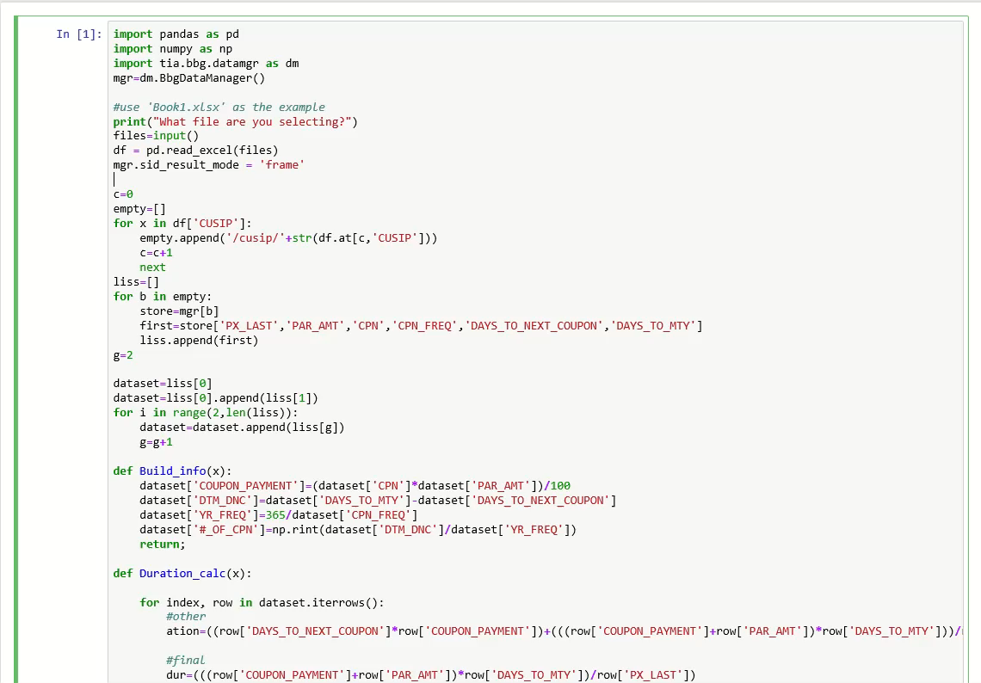
Notes:
Matt R

Slide 8
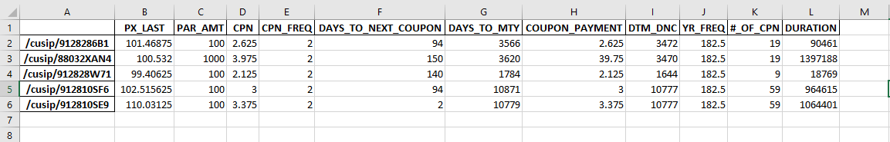
Demo (cont)
Possible end data
You can perform any operation on this data as if it were a normal dataframe such as to_excel()
Can be found at
https://github.com/bobsbestie/FinalProject/blob/master/datamgr.ipynb

Slide 9
Conclusion
What we learned
What challenges we faced

Slide 10
Thank You
Questions?

